Slide 1


Geodatabase API
Esri Developer Summit
March 8–11, 2016 | Palm Springs, CA
Thomas Emge

Slide 2

Geodatabase API

Slide 3

Architecture
The ArcGIS.Core.Data API is a DML-only (Data Manipulation Language) API.
Schema creation and modification are performed using the Geoprocessing API.
Almost all methods need to be executed on the main CIM thread
Call within QueuedTask.Run
Ensure proper handling of IDisposible objects by either calling Dispose() explicitly or the using {} statement

Slide 4
Geodatabase
Open a file geodatabase
// Opens a file geodatabase. This will open the geodatabase if the folder
// exists and contains a valid geodatabase.
using (Geodatabase geodatabase =
new Geodatabase(@"C:\Data\LocalGovernment.gdb"))
{
// Use the geodatabase.
}

Slide 5
Geodatabase from Connection properties
Use ConnectionProperties for enterprise geodatabases (or path to .sde file)
// Opening a Non-Versioned SQL Server instance.
ConnectionProperties connectionProperties = new ConnectionProperties
{
AuthenticationMode = AuthenticationMode.DBMS,
DBMS = EnterpriseDatabaseType.SQLServer,
// Where testMachine is the machine where the instance is running and
// testInstance is the name of the SqlServer instance.
Instance = @"testMachine\testInstance",
// Provided that a database called LocalGovernment has been created on
// the testInstance and geodatabase has been enabled on the database.
Database = "LocalGovernment",
…

Slide 6
Geodatabase from Connection properties (continued)
…
// Provided that a login called gdb has been created and corresponding
// schema has been created with the required permissions.
User = "gdb",
Password = "password",
Version = "dbo.DEFAULT"
};
using (Geodatabase geodatabase = new Geodatabase(connectionProperties))
{
// Use the geodatabase.
}

Slide 7
Open a table
Open a table by name
using (Geodatabase geodatabase = new Geodatabase(connectionProperties))
{
// open the dataset by name to get a table reference.
using (Table table =
geodatabase.OpenDataset<Table>("LocalGovernment.GDB.EmployeeInfo"))
{
// use the standalone table
}
}

Slide 8
Open a feature class
Open a feature class by name
using (Geodatabase geodatabase = new Geodatabase(connectionProperties))
{
// Open a featureClass (within a feature dataset or
// outside a feature dataset).
using (FeatureClass featureClass =
geodatabase.OpenDataset<FeatureClass>("LocalGovernment.GDB.AddressPoint"))
{
}
}

Slide 9
Opening feature classes
Enumerate feature classes within a dataset
using (FeatureDataset featureDataset =
fileGeodatabase.OpenDataset<FeatureDataset>("Address"))
{
IReadOnlyList<Definition> definitions =
fileGeodatabase.GetRelatedDefinitions(featureDataset.GetDefinition(),
DefinitionRelationshipType.DatasetInFeatureDataset);
foreach (Definition definition in definitions)
{
if (definition.DatasetType == DatasetType.FeatureClass)
{
dataset = featureDataset.OpenDataset<Table>(definition.GetName());
}
Notes:
Querying the schema information (Definition) of all that is inside the feature dataset.
Then opening table version of each feature class inside.

Slide 10
Schema information
Retrieve the schema information from a feature class
using (var geodatabase = new Geodatabase(@"c:\data\LocalGovernment.gdb"))
{
// Open a featureClass (within a feature dataset or
// outside a feature dataset).
using (FeatureClass featureClass =
geodatabase.OpenDataset<FeatureClass>("AddressPoint"))
{
var fcDefinition = featureClass.GetDefinition();
string areaFieldName = fcDefinition.GetAreaField();
}
}
Notes:
Going directly to the source

Slide 11
Querying FeatureClass or Table for the data store
Working from a layer back to the source
var basicFeatureLayer = ActiveMapView.Map.Layers[0] as BasicFeatureLayer;
var featureLayer = ActiveMapView.Map.Layers[0] as FeatureLayer;
var standAloneTable = ActiveMapView.Map.StandaloneTables[0];
QueuedTask.Run(() => {
var gdb = standAloneTable.GetTable().GetDatastore() as Geodatabase;
var gdb = basicFeatureLayer.GetTable().GetDatastore() as Geodatabase;
var gdb = featureLayer.GetFeatureClass().GetDatastore() as Geodatabase;
// however the feature layer could also be...
var svc = featureLayer.GetFeatureClass().GetDatastore() as FeatureService;
});
Notes:
Go to the source from the map.
FeatureService new at 1.2

Slide 12
Versions
Connect to specific versions
// open geodatabase from the the GDBItem
Geodatabase geodatabase = new Geodatabase(gdbItem.Path);
// retrieve the version manager from the gdb
VersionManager versionManager = geodatabase.GetVersionManager();
IReadOnlyList<Version> existingVersions = versionManager.GetVersions();
// connect to a specific version
existingVersions[1].Connect();
// open the feature class
var featureClass = geodatabase.OpenDataset<FeatureClass>("SimpleLines");

Slide 13

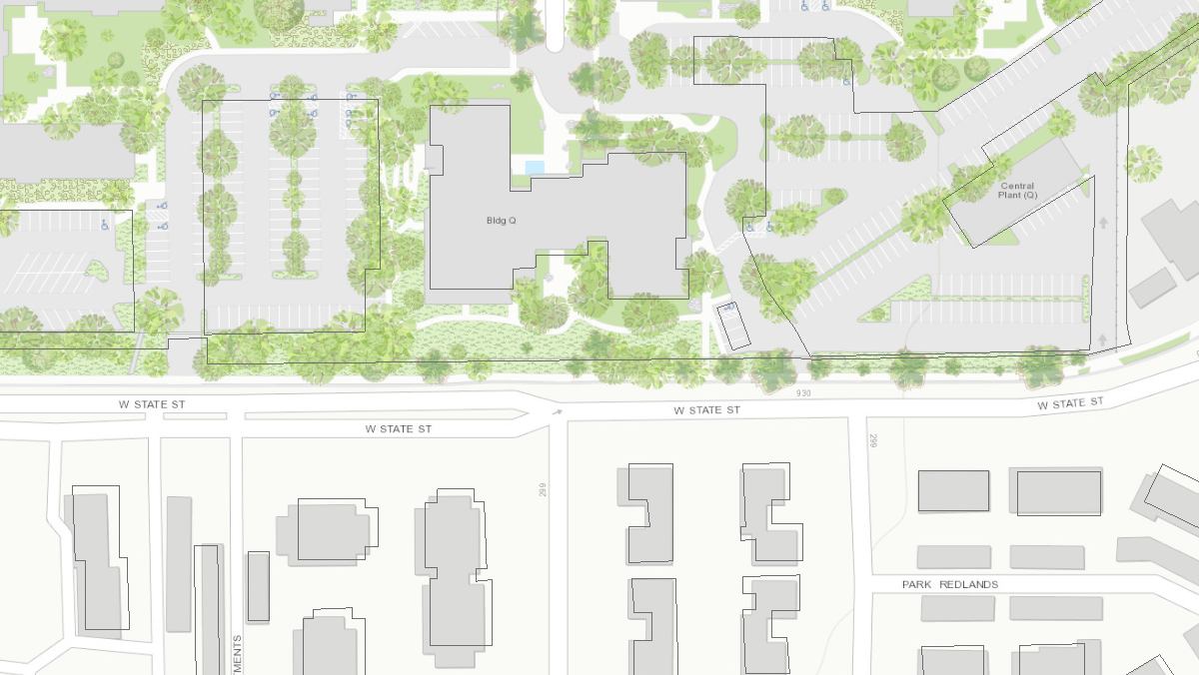
Demo FeatureService

Slide 14
QueryFilter
Use QueryFilter to narrow down search results
// return all features
RowCursor rowCursor = table.Search(null, false);
QueryFilter queryFilter = new QueryFilter
{
WhereClause = "COSTCTRN = 'Information Technology'",
SubFields = "KNOWNAS, OFFICE, LOCATION",
PostfixClause = "ORDER BY OFFICE"
};
// return specified features
RowCursor rowCursor = table.Search(queryFilter, false);

Slide 15
Rows and Features
Search on the table / feature class
// use the results from the search in a cursor
using (RowCursor rowCursor = table.Search(queryFilter))
{
while (rowCursor.MoveNext())
{
// get the current row
using (Row row = rowCursor.Current)
{
string location = Convert.ToString(row["LOCATION"]);
Notes:
Using Row object because we have a Table, not a FeatureClass object….

Slide 16
Rows and Features (continued)
Feature is a type of Row
// use the results from the search in a cursor
using (RowCursor featureCursor = fc.Search(spatialQueryFilter))
{
while (featureCursor.MoveNext())
{
// cast the current row as a feature
using (Feature feature = featureCursor.Current as Feature)
{
// Process the feature. For example...
Console.WriteLine(feature.GetObjectID());
}
}
}
Notes:
…but can cast it.

Slide 17
Selection
Use selection to gather IDs of rows
// construct a spatial query filter
SpatialQueryFilter spatialFilter = new SpatialQueryFilter
{
WhereClause = "FCODE = 'Park'",
FilterGeometry = PolygonBuilder.CreatePolygon(searchCoordinates),
SpatialRelationship = SpatialRelationship.Crosses
};
// For Selecting all matching entries.
// The SelectionOption.Normal is the default parameter.
Selection mySelection = featureClass.Select(spatialFilter);
// store the list of returned IDs
var listofIDs = new List<long>(mySelection.GetObjectIDs());

Slide 18
Relationship classes
Search on the table / feature class
// get the relationship class from the geodatabase
using (AttributedRelationshipClass relationshipClass =
geodatabase.OpenDataset<AttributedRelationshipClass>("ParcelToBuilding"))
// get the contributing feature class
using (FeatureClass parcelFeatureClass =
geodatabase.OpenDataset<FeatureClass>("Parcel"))
{
// make a feature selection from origin features
Selection parcels = parcelFeatureClass.Select(
new QueryFilter { WhereClause = "APN = 1234 OR APN = 5678" });
// get destination rows
IReadOnlyList<Row> destinationRows =
relationshipClass.GetRowsRelatedToOriginRows(parcels.GetObjectIDs());
}
Notes:
Currently not possible to ask feature class what relationship classes it participates in. Only as rel. class what feat. classes it has.

Slide 19
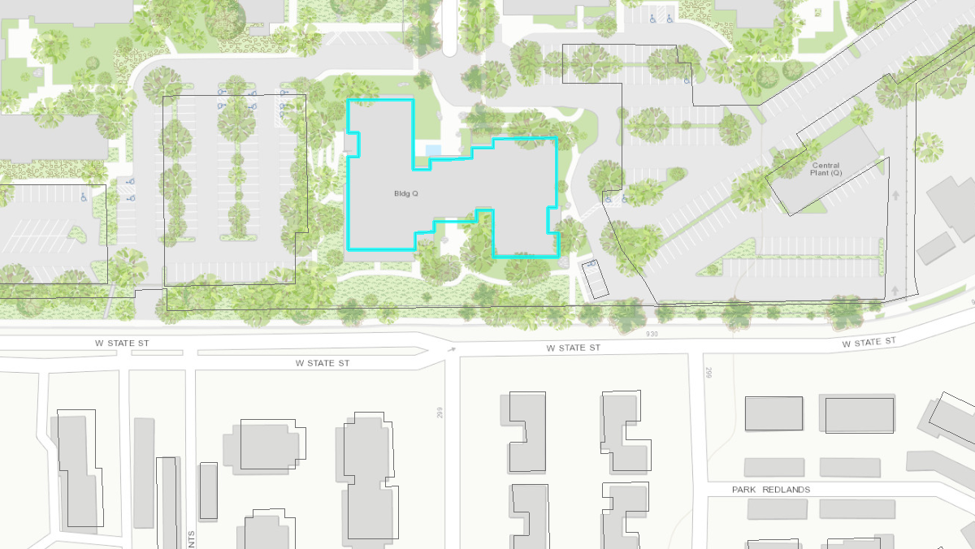
Demo FeatureService II

Slide 20
Editing (in stand-alone mode)
Performing edits outside of ArcGIS Pro is referred to as stand-alone mode
using (var featureCursor = featureClass.Search(null, false))
{
// set up GDB transaction through delegate
geodatabase.ApplyEdits(() =>
{
// create new feature
RowBuffer featureBuffer = featureClass.CreateRowBuffer();
featureBuffer["Name"] = "ArcGIS Pro SDK";
featureBuffer.Dispose();
});
}
Notes:
Encouraged to use edit operations when manipulating features. However, it is possible to edit as standalone mode (no undo/redo, but all will revert if an error before done).
“Outside of Pro”: see CoreHost ProConcept on wiki page.

Slide 22




